Slide 1
Supervised Learning: Predicting Wine Quality Classification Problem
Nariman Pashayev

Slide 2
Contents
Main Objectives
Data Description
Data Exploration And Analysis
Machine Learning Analysis and Modelling
Key Findings and Recommendations

Slide 3
DATA DESCRIPTION AND ANALYSIS SECTION

Slide 4
Main Objectives
Two datasets are included, related to red and white vinho verde wine samples, from the north of Portugal.
The goal is to model (predict) wine quality based on physicochemical tests by using ML classification techniques
The dataset was downloaded from the UCI Machine Learning Repository, alsa available in Kaggle.
https://www.kaggle.com/code/narimanpashayev/predicting-wine-quality-with-different-models/data

Slide 5
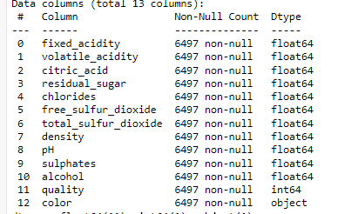
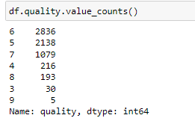
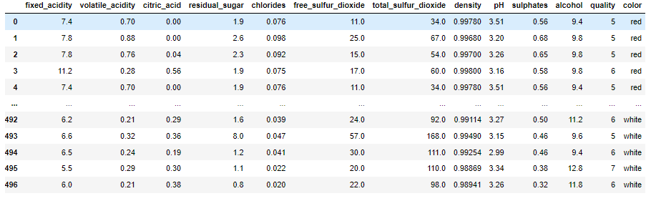
Data Description
The Wine data set contains 13 attributes
Data types are 11 floats, 1 integer, and 1 object type
There are a total of 6497 rows in the dataset
The goal is to predict wine quality based on its attributes
The quality range is 3-9.
So I decided [2-6] as a bad quality wine and (6-10] good quality wine

Slide 6
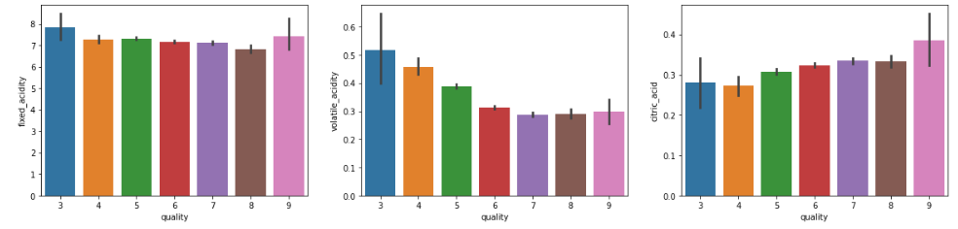
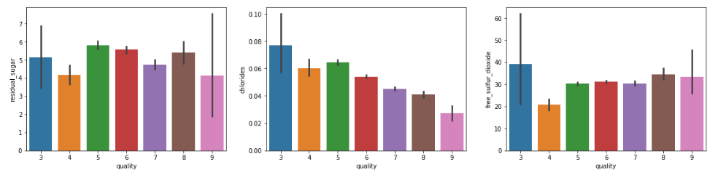
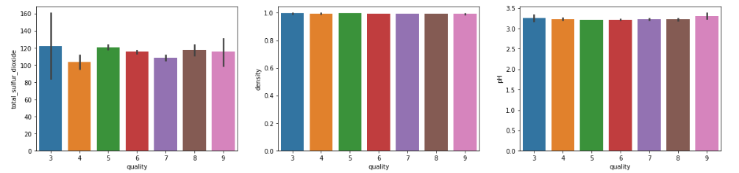

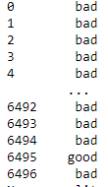

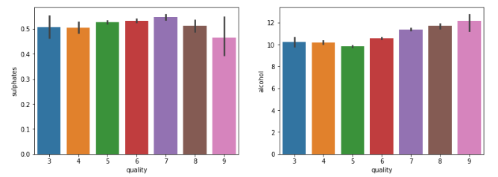
Data Exploration and Analysis-1
Here we see that fixed acidity, and residual sugar, does not give any specification to classify the quality.
Wine quality increases as the volatile acidity and chlorides decreases
Higher quality wines contains higher citric acid and alcohol
Other contents does not tell much how they change quality of wine
As mentioned before, wine quality converted into bad and good quality wine from integer values and then label encoded into 0 (bad quality) and 1 (good quality)
Also color column was removed from the dataset

Slide 7
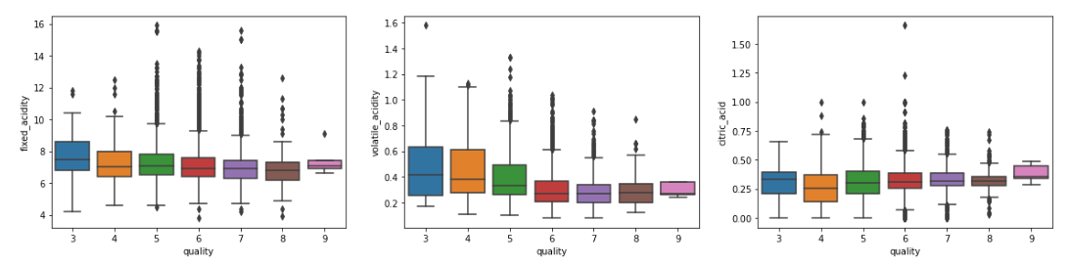
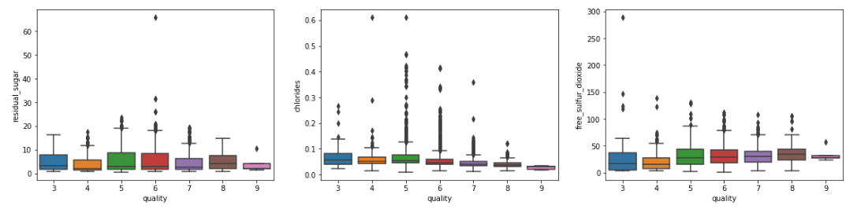
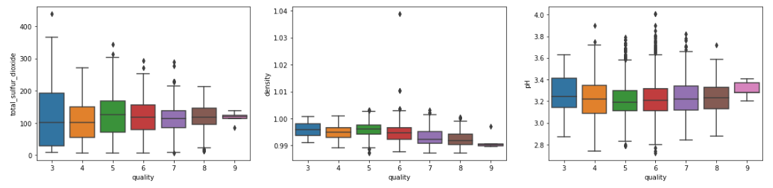
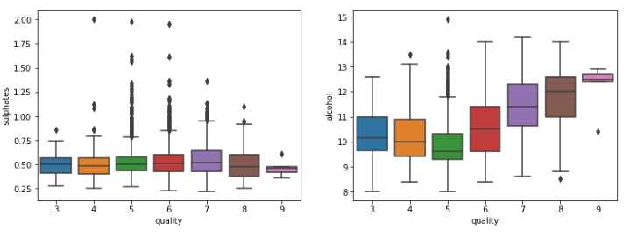
Data Exploration and Analysis-2
Boxplot shows there are quite outliers for every column especially fixed_acidity, volatile-acidity, citric_acid, chlorides, sulphates

Slide 8
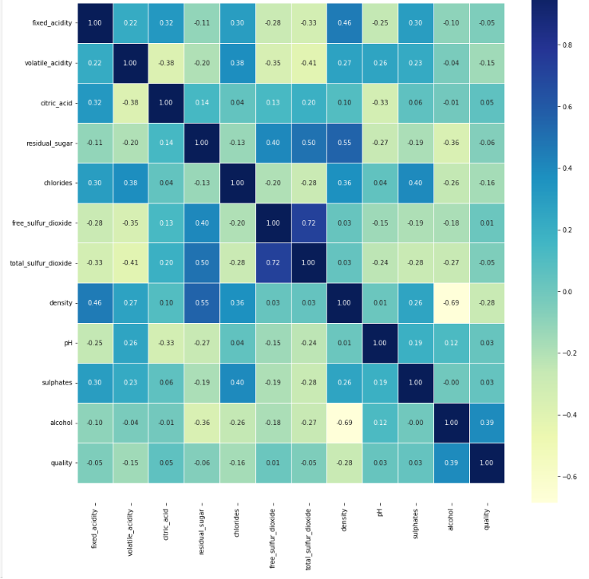
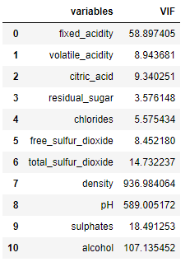
Data Exploration and Analysis-3
Studying the correlations between features using Heat Map
Both from correlation heatmap and Variance Inflation Factor, it is seen that there are multicollinear features.
Density, pH, alcohol and fixed_acidity are the most multicollinear features

Slide 9
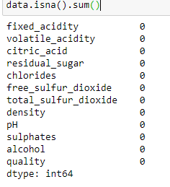
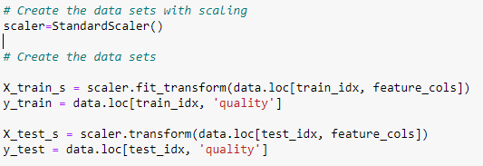
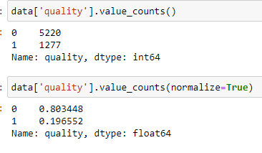
Data Exploration and Analysis-4
There are no NULL values in the data set, which is a good thing
Target values are imbalanced, 80% (5220) are bad quality, while 20% (1277) are good quality wine
So, StratifiedShuffleSplit ( with test_size=0.2) method was used to keep that balance while dividing the data into train and test splits
Then, all the features are scaled with StandardScaler()

Slide 10
MACHINE LEARNING ANALYSIS AND KEY FINDINGS SECTION

Slide 11
Machine Learning-1
In the Machine Learning section, I used below ML classification techniques for predicting the wine quality
While building these models, I have used the GridSearchCV technique for hyperparameter tuning
As a metric to compare the results, I used ‘F1’ score in the GridSearchCV
Also for each GridSearchCV , I divided data into 4 folds using cross-validation
Results are given as in the form of Classification_Report and Confusion Matrix
1.Logistic Regression
2. KNN Algorithm
3.SVM Algorithm
4.Decision Tree Algorithm
5.Bagging Techniques
Bagging with SVM
Bagging with Decision Tree
Random Forest
6.Boosting Algorithms
Gradient Boosting
AdaBoost Classifier
XGBoost Classifier

Slide 12
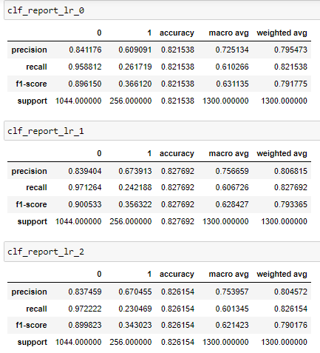
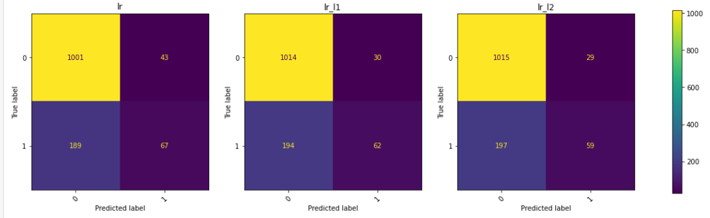
Machine Learning-Logistic Regression
I tried all the 3 methods here, Vanilla, Ridge and Lasso Regularizations
All 3 methods did w
As we can see, Vanilla, Lasso and Ridge regressions showed approximately the same results on both class 0 and class 1.
Despite the accuracy is around 82% for 3 of them, but recall and F1-score is much lower on class 1.
All 3 models did well on predicting class 0, while did not good enough for Class 1
This is due to the imbalance between those classes (80% of target value are class 1-bad quality and 20% are class 2-good quality).

Slide 13
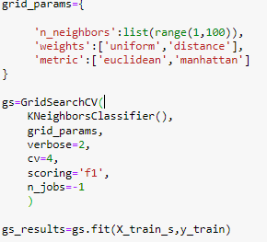
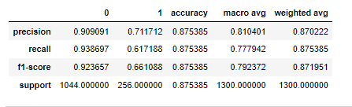
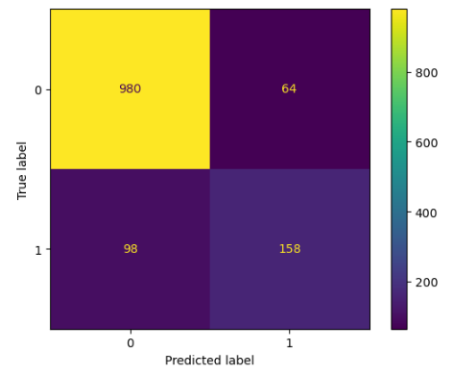

Machine Learning-KNN Algorithm
KNN algorithm gave the best results with
n_neighbors=8, metric=Euclidean and weights=distance
Accuracy increased to 87.5%
F1 score=66.11% for Class 1 and 92.36% for Class 0
KNN obviously did better than Logistic Regression

Slide 14
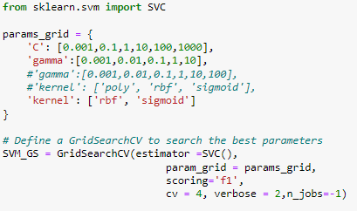
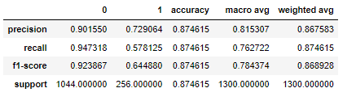

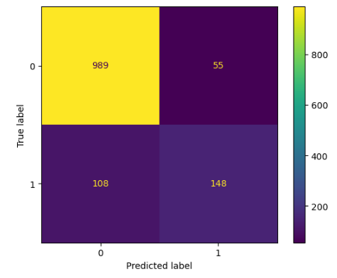
Machine Learning-SVM Algorithm
KNN algorithm gave the best results with
C=10, gamma=1 and kernel=rbf
Accuracy =87.46%
F1 score=64.48% for Class 1 and 92.38% for Class 0

Slide 15
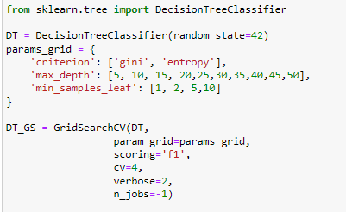
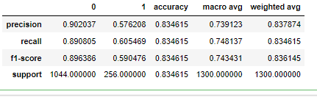

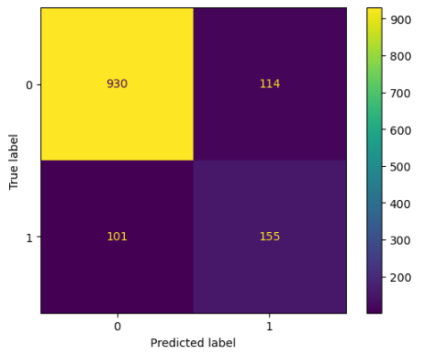
Machine Learning-DT Algorithm
DT algorithm gave the best results with
Ccriterion=entropy, max_depth=25 and min_samples_leaf=1
Accuracy =83.46%
F1 score=59.05% for Class 1 and 89.63% for Class 0

Slide 16
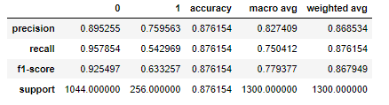
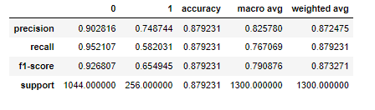
Machine Learning-Bagging
Bagging algorithm both with SVM and DT Classifiers gave the same results
But Bagging with DT classifier predicted the Class 1 a little bit more accurately than Bagging with SVM
F1 score=65.49%
Accuracy=87.92%
Bagging with SVM
Bagging with DT Classifier

Slide 17
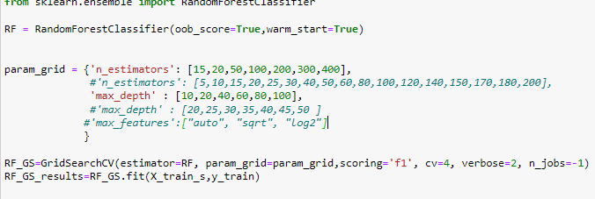
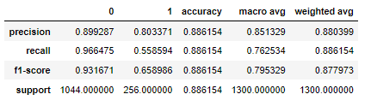

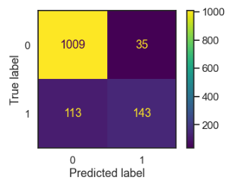
Machine Learning-Random Forest
Random Forest algorithm gave the best results with
max_depth=100 and n_estimators=300
Accuracy =88.61%
F1 score=65.89% for Class 1 and 93.16% for Class 0

Slide 18
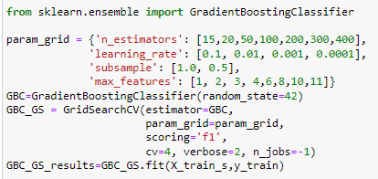
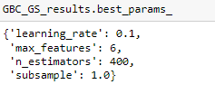
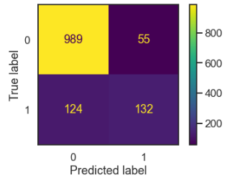
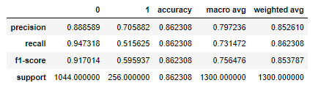
Machine Learning-Gradient Boosting
Gradient Boosting algorithm gave the best results with
Accuracy =86.23%
F1 score=59.59% for Class 1 and 91.70 % for Class 0

Slide 19
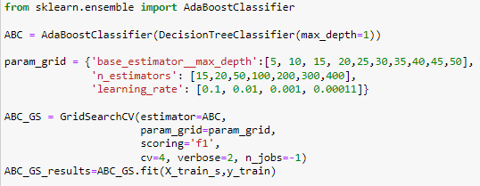

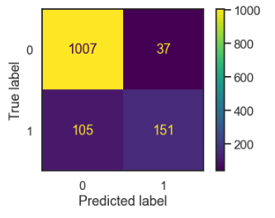
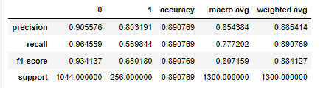
Machine Learning-AdaBoost
AdaBoosting algorithm gave the best results with
Accuracy =89.07%
F1 score=68.01% for Class 1 and 93.41 % for Class 0

Slide 20
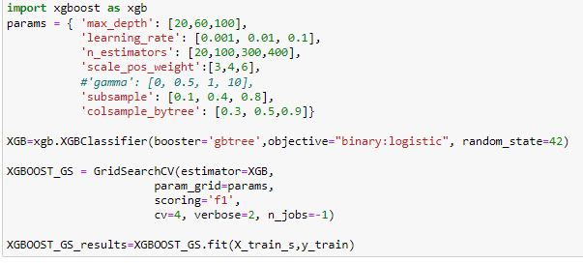
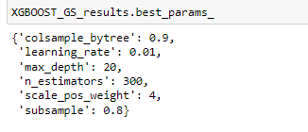
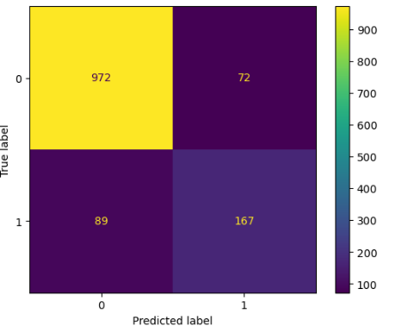
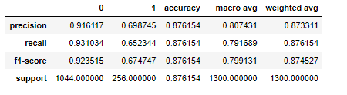
Machine Learning-XGBoost
XGBoost algorithm gave the best results with
Accuracy =87.61%
F1 score=67.47% for Class 1 and 92.35 % for Class 0

Slide 21
Findings,Results and Recommendations
Key Findings and Results
Wine quality data set is imbalanced 80% Class 0 and 20% Class 1
There are quite outliers for every column especially
fixed_acidity, volatile-acidity, citric_acid, chlorides, sulphates
Density, pH, alcohol, and fixed_acidity are the most multicollinear features
All the models did well on predicting class 0 , while did not good enough for Class 1
This is due to the imbalance between those classes
Among those models, AdaBoost and XGBoost did fairly well. They both predicted the Class 0 with Accuracy=87-89%, F1=92-93%, Precision=90-91% and Recall=93-96%
But Class 1 prediction of these 2 is not that high
Accuracy=87-89%, F1=67-68%, Precision=70-80% and Recall=59-65%
Recommendations:
In order to increase the predictability of Class 1, the data can be balanced before modelling
Different metrics like AUC score can be used
Different weight parameters in XGBoost can be checked
Oversampling or Undersampling methods can be used
 | Accuracy | Precision(Class 1) | Recall (Class 1) | F1 score (Class 1)
Logistic Regression | 82.15 | 60.9 | 26.17 | 36.6
KNN | 87.5 | 71.17 | 61.71 | 66.11
SVM | 87.46 | 72.9 | 57.81 | 64.48
DT | 83.46 | 57.62 | 60.54 | 59.04
Random Forest | 88.61 | 80.33 | 55.85 | 65.89
Gradient Boosting | 86.23 | 70.58 | 51.56 | 59.59
AdaBoost | 89.07 | 80.31 | 58.98 | 68.01
XGBoost | 87.61 | 69.87 | 65.23 | 67.47
 | Accuracy | Precision(Class 0) | Recall (Class 0) | F1 score (Class 0)
Logistic Regression | 82.15 | 83.74 | 97.22 | 89.98
KNN | 87.5 | 90.90 | 93.86 | 92.36
SVM | 87.46 | 90.15 | 94.73 | 92.83
DT | 83.46 | 90.20 | 89.08 | 89.63
Random Forest | 88.61 | 89.92 | 96.64 | 93.16
Gradient Boosting | 86.23 | 88.58 | 94.73 | 91.7
AdaBoost | 89.07 | 90.55 | 96.45 | 93.41
XGBoost | 87.61 | 91.61 | 93.10 | 92.35

